Slide 1
Welcome to the MSWDSTv2 Tutorial
Notes:
Welcome to the Municipal Solid Waste Decision Support Tool version 2 (MSW DST v2) tutorial.
Collecting and managing MSW is an essential utility service provided by cities. Quick and effective data and tools for planning and managing MSW are essential for cities to make better-informed investment decisions in MSW infrastructure and management strategies. To address the need for improved analytical tools to support decision making, the U.S. Environmental Protection Agency (EPA) developed the MSW Decision Support Tool (MSW DST). The original version [1.0] of the MSW DST was made available as a free, publicly accessible tool in 2012. Annual updates were made to the default data and assumptions used in the MSW DST.
Through recent NSF funding received by North Carolina State University (NCSU), the methods and data used in the underlying process models of the MSW DST were reviewed and updated. In addition, the overall model design was restructured into the NCSU Solid Waste Optimization Life-cycle Framework (SWOLF). EPA, NCSU and RTI International worked to develop a new user interface to SWOLF so that it could be released as a new user-friendly and publicly available tool; the MSW DST v2.

Slide 2
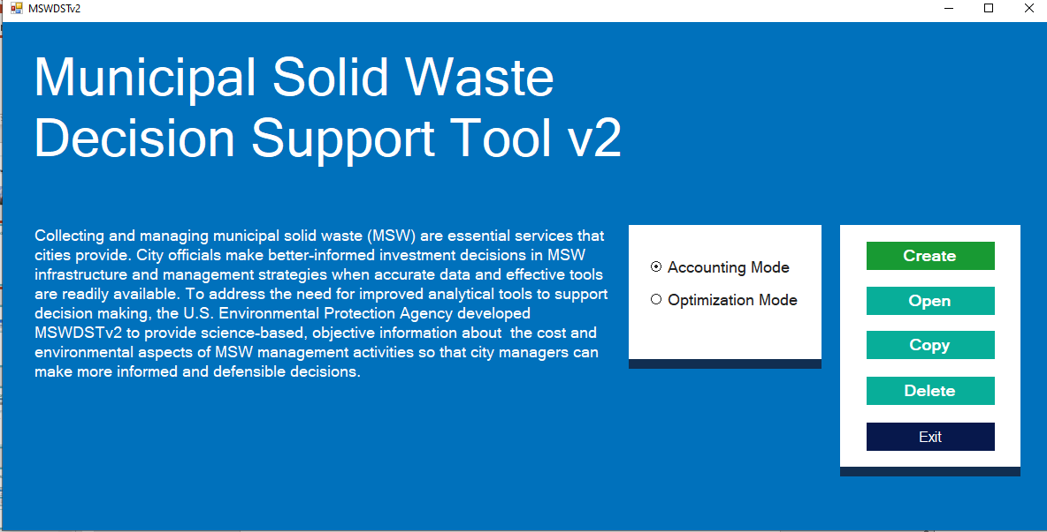
Getting Started Opening the MSW DST v2
Notes:
When you open the MSWDSTv2, you will see the introductory screen shown here. Accounting Mode allows the user to specific the flow of material to enabled management pathways. Optimization Mode allow the user to optimize on a selected goal, such as minimizing carbon emissions. To create a new accounting mode or optimization mode, click the desired radial button and then initiate the session by clicking the “Create” button. You will be prompted to specify a name for your session. Use a descriptive name such as: Durham_NC_basecase.
If you already created a session, you can load an existing scenario by clicking “Open”. You will be prompted to select the scenario file. However, this training focuses on the series of steps required to complete a new scenario if you had selected the button “Create.” The screens included in this use the default settings to help familiarize you with all of the screens and options.

Slide 3
Getting Started Main Model Steps
The steps to complete a full scenario include:
Define waste generation sectors and amounts – required
Define waste composition – optional
Select waste collection processes – required
Select waste destinations (i.e., recycling, treatment or disposal) – required
Define allocation of waste among processes (accounting mode) – optional
Define electrical energy grid and carbon accounting methodology – optional
Define collection and transportation distances – optional
Input process specific data or assumptions – optional
Define optimization objective and constraints (optimization mode) – optional
Solve and view reports – required
Notes:
The MSW DST v2 is fully populated with US national average data for waste characteristics and management facility design and operating costs, materials and energy consumption and emissions. In addition, default data assumptions are provided for collection and transportation distance and electrical energy generation.
To complete a scenario run, only a few steps are required. In this slide the main steps of the MSW DST v2 are listed and those that are required and optional noted. The required steps include defining:
waste generation (for at least one sector),
collection processes (“residual” waste collection at a minimum),
management (i.e, recycling, treatment and/or disposal) destinations, and
creating a solution.
All other steps in the MSW DST v2 allow you to tailor the scenario to a specific location or study design. As noted in this slide, two steps are unique to whether the MSW DST v2 is run in “Accounting” or “Optimization” mode and user input to these steps is optional. As with the other options steps, these accounting and optimization mode-specific steps will be pre-populated based on default settings.

Slide 4
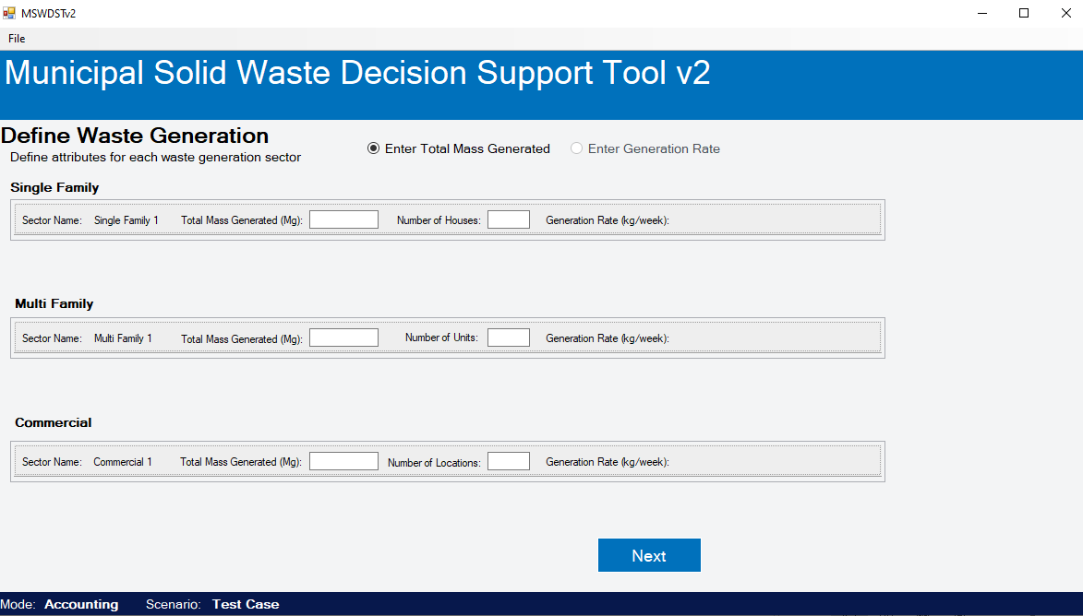
Entering Data Define Waste Generation
Notes:
The “Define Generation” step allows you to define the overall tonnage of waste modeled, as well as different tonnages by multiple waste generation sectors, including up to two residential, two multi-family, and five commercial waste generation sectors. A single sector (e.g., single family) is enabled as a default setting, and not all sectors need to be used. By defining additional sectors, you can capture differences associated with varying demographic or infrastructure characteristics to more accurately represent your scenario. However, keep in mind that adding in more sectors creates a more complex model to manage and run. For a basic analysis where sectors are not important, we recommend using a single sector, namely the single family sector.
When finished entering waste generation data, click the “Next” button at the bottom of the screen. You will automatically move to the next step if the data were entered correctly. An error message will appear if a data entry error exists. Review your data entry, correct any errors and click the “Next” button again.

Slide 5
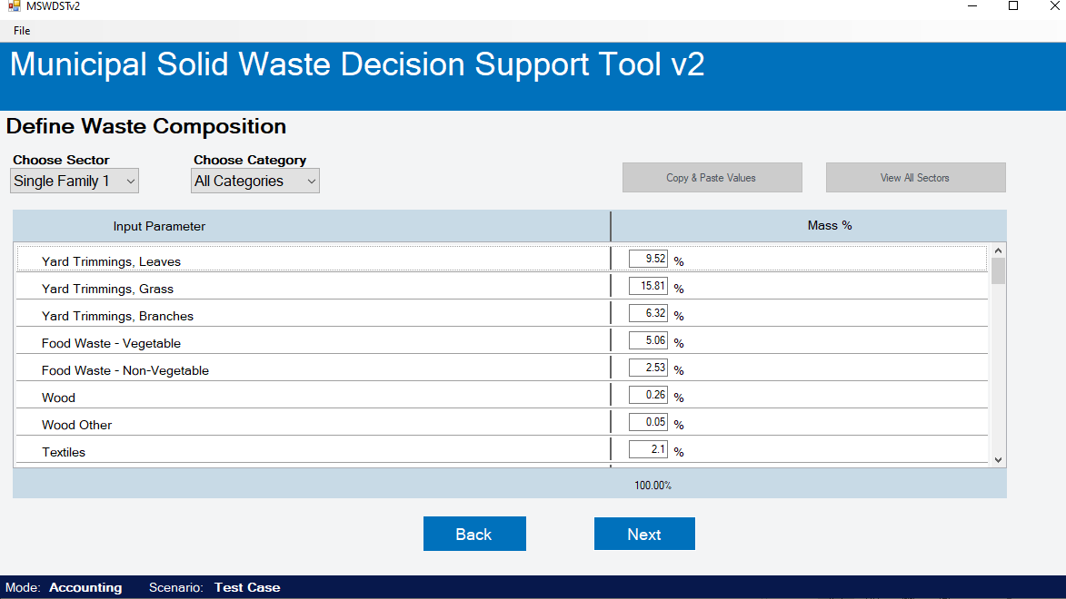
Entering Data Define Waste Composition
Notes:
The “Define Waste Composition” step allows you to define the composition of waste modeled by sector. The default settings represent the US EPA’s national average MSW composition and can be replaced with site or study specific composition data. Note that the composition must total to 100%.
When finished entering waste generation data, click the “Next” button at the bottom of the screen. You will automatically move to the next step if the data were entered correctly. An error message will appear if a data entry error exists. Review your data entry, correct any errors and click the “Next” button again.

Slide 6
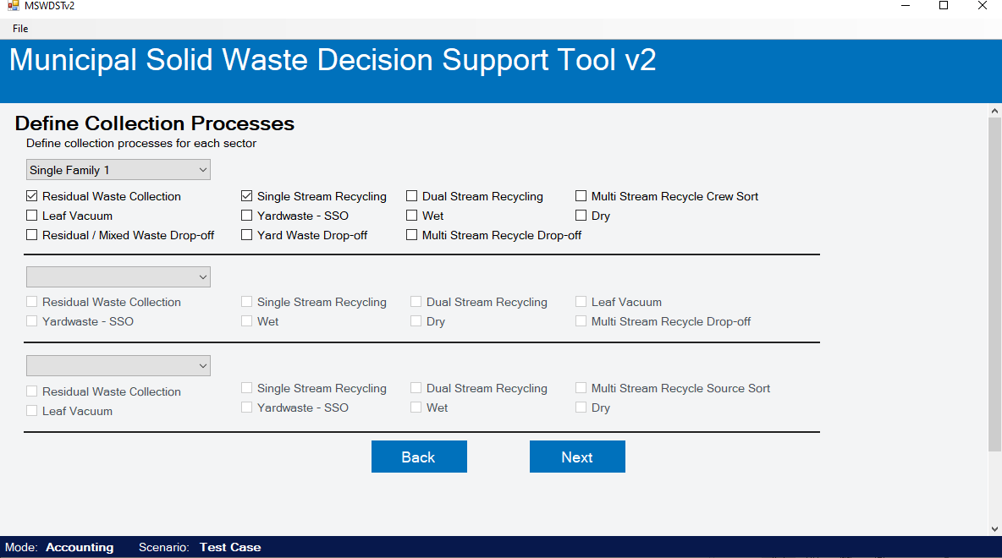
Entering Data Select Collection Processes
Notes:
This step allows you to select the specific type of waste collection to include in the model build and scenario analysis. Most commonly used options for waste, recyclables and compostables collection are included. Click on the checkbox next to the desired collection option to enable it. Note that collection options selected and downstream management process selections need to match. For example, if you select single stream recyclables collection in the residential sector then you also need to select a single-stream type materials recovery facility (MRF) in the next step of the model.
Click the “Next” button at the bottom of the screen when finished selecting the processes you wish to analyze. You will automatically move to the next step if the data were entered correctly. An error message will appear if a data entry error exists. Review your data entry, correct any errors and click the “Next” button again.

Slide 7
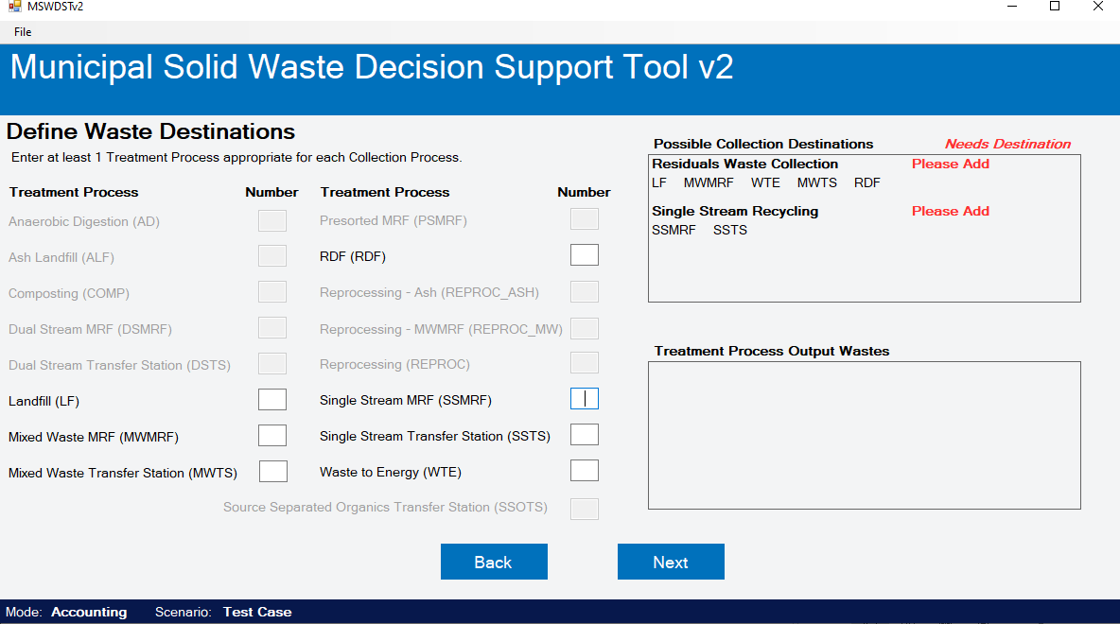
Entering Data Define Waste Destinations
Notes:
This step allows you to select the specific processes to include in the model build and scenario analysis. Most conventional processes are included for multiple design options. Enter a “1” in the box next to the specific destination to enable it. A numerical value is entered since multiple destinations of the same type (e.g., two MRFs in the regions) can be modeled. Note that destination selections need to match. For example, if you selected single stream recyclables collection in the previous step, then you can only select a single-stream type materials recovery facility (MRF) in this step. In addition to selecting the single-stream MRF, users also select “Reprocessing” to capture the reprocessing of recovered materials into new materials.
If you wish to change the selection of collection options, click the “Back” button to return to the previous “Select Waste Collection Processes” step.
The panels on the right side of the screen indicate whether destinations have been assigned and are valid. You must complete the valid assignment for all destination(s) before proceeding to the next steps. Once all destinations show as valid, click the “Next” button at the bottom of the screen and you will automatically move to the next step.

Slide 8
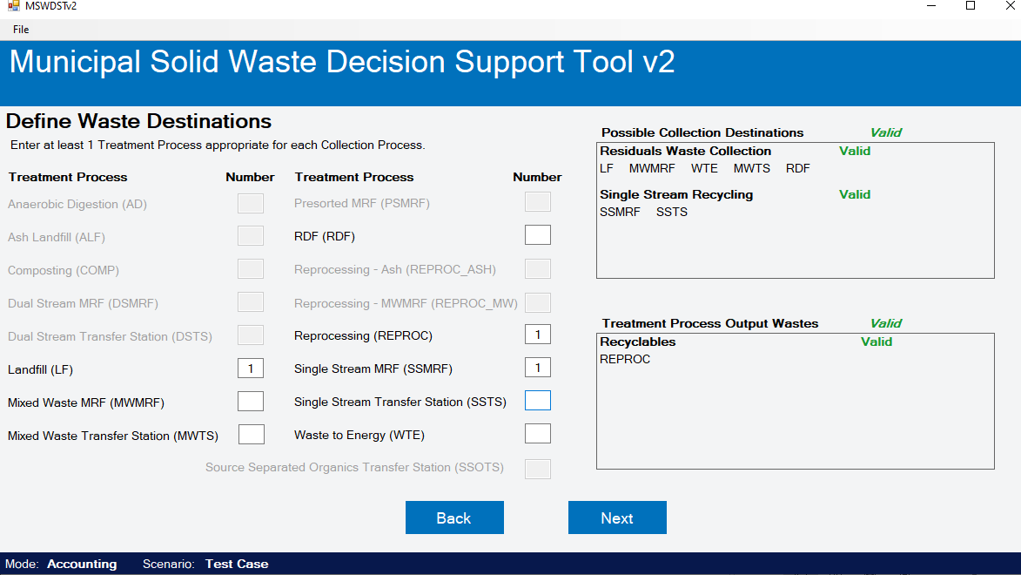
Entering Data Select Waste Destinations
Notes:
This step allows you to select the specific processes to include in the model build and scenario analysis. Most conventional processes are included for multiple design options. Enter a “1” in the box next to the specific destination to enable it. A numerical value is entered since multiple destinations of the same type (e.g., two MRFs in the regions) can be modeled. Note that destination selections need to match. For example, if you selected single stream recyclables collection in the previous step, then you can only select a single-stream type materials recovery facility (MRF) in this step. In addition to selecting the single-stream MRF, users also select “Reprocessing” to capture the reprocessing of recovered materials into new materials.
If you wish to change the selection of collection options, click the “Back” button to return to the previous “Select Waste Collection Processes” step.
The panels on the right side of the screen indicate whether destinations have been assigned and are valid. You must complete the valid assignment for all destination(s) before proceeding to the next steps. Once all destinations show as valid, click the “Next” button at the bottom of the screen and you will automatically move to the next step.

Slide 9
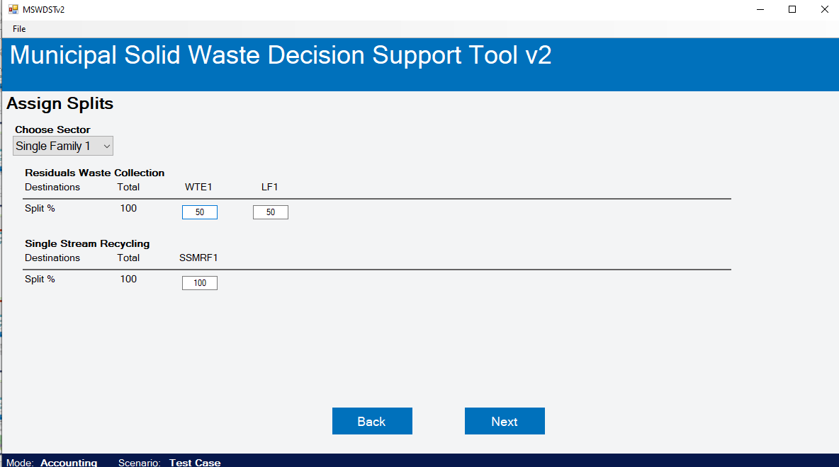
Accounting Mode Only Assign Destination Splits
Notes:
When running the tool in accounting mode, this step will allow you to define the split of waste sent to different destinations by sector and waste collection type. Note that this step is not included when running the tool in optimization mode. As shown in the example screen, residual waste collected may be sent to a landfill or WTE facility. A 50/50 split was assigned and thus 50 percent of the residual waste will be sent to WTE and 50 percent to landfill. For single-stream recycling, the only destination selected is a single stream MRF and therefore 100 percent of the single stream recyclables collected will be sent to the single stream MRF.
Different allocations may be assigned for each enabled generation sector. Use the “Choose Sector” drop-down menu to select the sector for assigning splits.
Once destination splits have been reviewed and kept as is or modified, click the “Next” button at the bottom of the screen and you will automatically move to the next step.

Slide 10
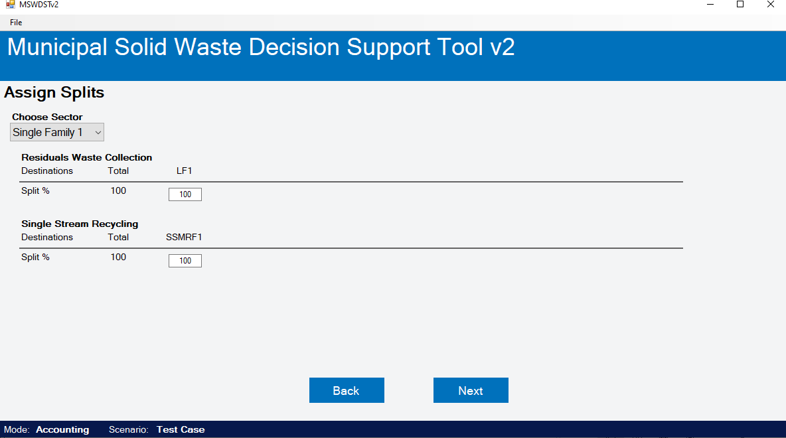
Accounting Mode Only Assign Destination Splits
Notes:
In accounting mode, you can define the split of waste sent to different destinations by waste collection. For example, residual waste collected may be sent to a landfill or WTE facility. In this screen capture, we did not enable WTE as a destination and therefore landfill is the only pathway available for residual waste. Likewise with single-stream recycling as the only destination selected is a single stream MRF. The next slide shows an example when multiple destinations are available.
Once destination splits have been reviewed and kept as is or modified, click the “Next” button at the bottom of the screen and you will automatically move to the next step.

Slide 11
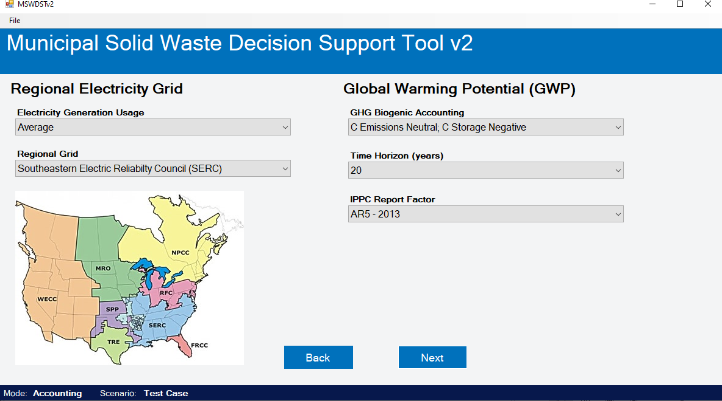
Entering Data Select Electricity Grid and Carbon Factors
Notes:
Selecting an electricity grid and carbon factors that are different from the default selection is also an optional step. However, when performing a site- or region- specific study, the selection of regional electricity grid can significantly impact the life cycle environmental results. To select a regional grid, click on the drop-down menu and select the grid according to the map. You may also select whether the life cycle emissions from the grid are based on the average grid mix or the fossil-based energy sources of the grid in the “Electricity Generation Usage” drop-down menu. As a default, the average grid mix of fuels is selected.
Different carbon accounting settings and factors are also optional. You can select via the drop-down menus the time horizon for carbon accounting and the specific IPCC global warming potential factors to use. In addition, you can also select how landfill carbon storage is handled. The default setting is for landfill carbon storage to be included as a negative value that is netted out of the landfill carbon emissions calculation. You may also select via the drop-down menu that landfill carbon storage be “neutral” and not netted out of the landfill carbon emissions calculation.
After all desired selections have been made, click the “Next” button and you will automatically move to the next step.

Slide 12
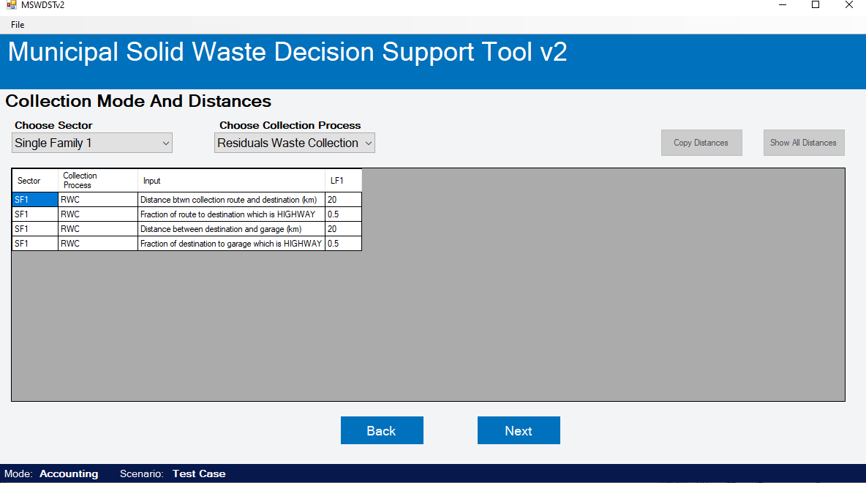
Entering Data Enter Collection and Transport Data
Notes:
Defining collection and transportation modes and distances is an optional step for completing a model run.
In this step, you can specify the distance between collection routes and the destination. This screen shows the distance (central nodal point) between residual waste collection and the landfill. A default value of 20 km is provided, and you can replace the default with a site- or study-specific value(s). You can also specify the distance from the destination, landfill in this case, back to the collection vehicle garage. In addition, you can define the percent split (based on 1.0 = 100%) for the fraction of the route that is highway.
You can specify the distances by generation sector (if multiple sectors are defined) via the “Choose Sector” drop-down menu. You also can specific the distance between other collection and destination combinations via the “Choose Collection Process” drop-down menu.
Click the “Next” button when finished. You will automatically move to the next step if the data were entered correctly. An error message will appear if a data entry error exists. Review your data entry, correct any errors and click the “Next” button again.

Slide 13
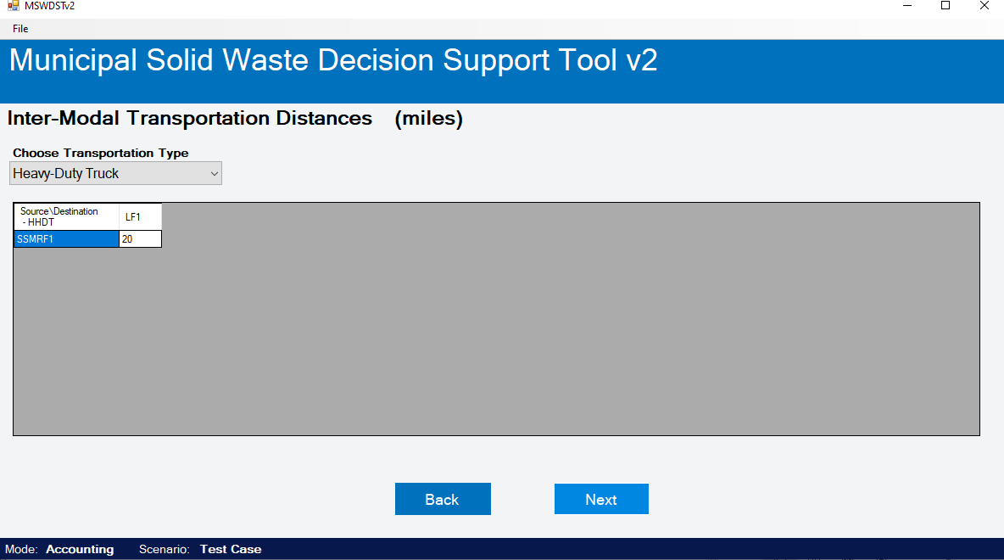
Entering Data Enter Collection and Transport Data
Notes:
Defining collection and transportation modes and distances is an optional step for completing a model run.
In this step, you can specify the inter-modal transportation distances between destinations (or facilities). This screen shows the distance between the Single Stream MRF (SSMRF) and the landfill for disposal of any residuals. A default value of 20 miles is provided, and you can replace the default with a site- or study-specific value(s). Different types of transportation including truck (heavy and medium duty), cargo shipping, barge shipping and rail can be selected via the drop-down menu.
Click the “Next” button when finished. You will automatically move to the next step if the data were entered correctly. An error message will appear if a data entry error exists. Review your data entry, correct any errors and click the “Next” button again.

Slide 14
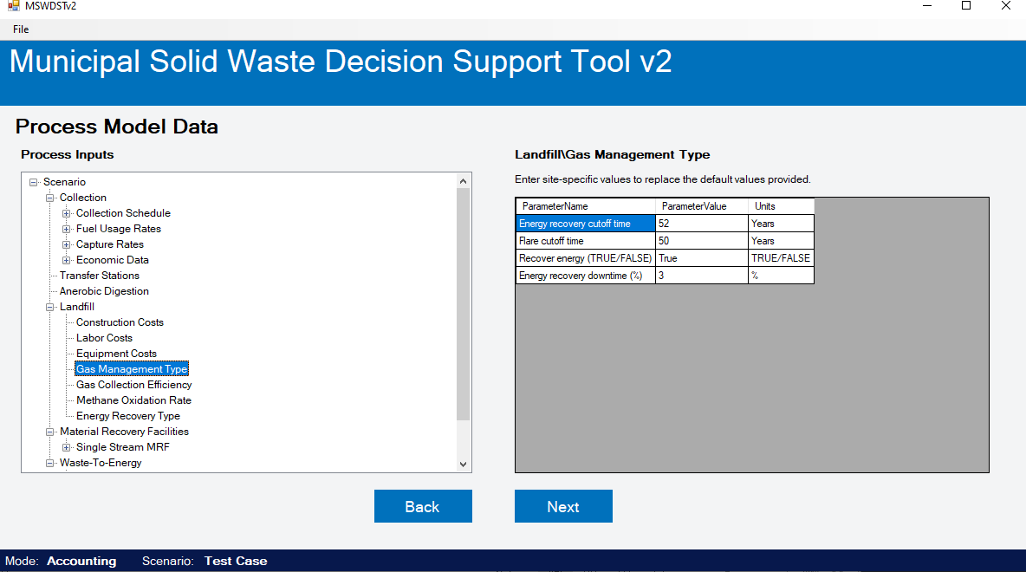
Entering Data Enter Process-Model Specific Data
Notes:
Entering process model data is an optional step for completing a model run.
In this step, you can tailor the collection and destination process economic, design, and operating default data and assumptions to reflect site- or study-specific performance (cost, energy consumption and emissions) characteristics and assumptions. The tree of processes can be expanded or collapsed for viewing. Click on the desired process model inputs to pull up. This screen shows landfill gas management type selected on the left panel and the tailorable data and assumptions are shown on the right panel and may be modified by the user.
Click the “Next” button when finished entering any process model specific data. You will automatically move to the next step if the data were entered correctly. An error message will appear if a data entry error exists. Review your data entry, correct any errors and click the “Next” button again.

Slide 15
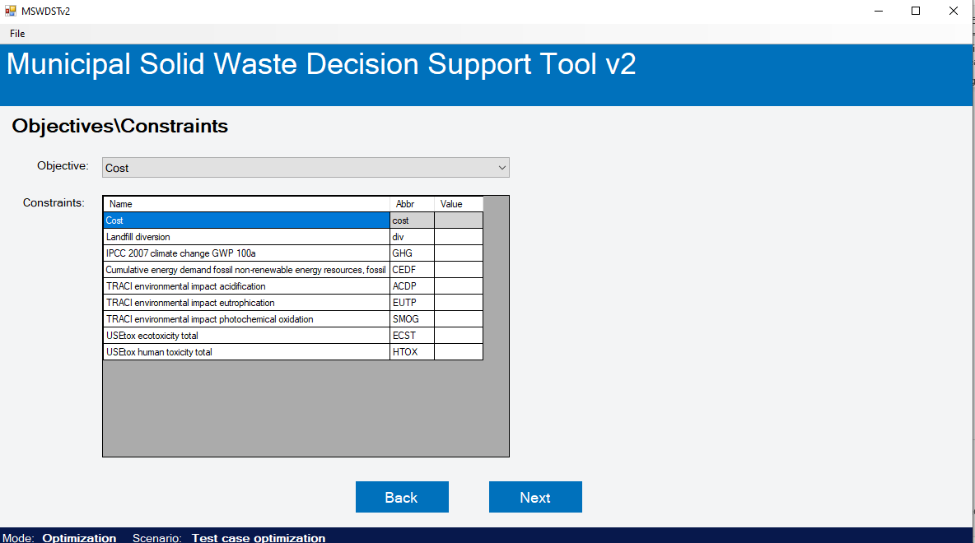
Optimization Mode Only Define Optimization Objective
Notes:
When running the tool in optimization mode, this step will allow you to define the objective and any constraints placed on optimization. Note that this step is not included when running the tool in accounting mode. As a default setting, cost is selected as the optimization objective. Thus, the tool will identify the solution that minimizes the total net cost for collection and managing the waste. Alternative objectives for optimization (e.g., landfill diversion, GHG emissions) can be selected by selecting the desired objective from the drop-down menu.
Constraints may also be placed on different objectives. For example, you can enter a maximum cost ceiling while optimizing on (minimizing) GHG emissions to identify a solution that, in this case, minimizes GHG emissions within the defined cost constraint.
split of waste sent to different destinations by waste collection. For example, residual waste collected may be sent to a landfill or WTE facility. In this screen capture, we did not enable WTE as a destination and therefore landfill is the only pathway available for residual waste. Likewise with single-stream recycling as the only destination selected is a single stream MRF. The next slide shows an example when multiple destinations are available.
After the optimization objective and any constraints are defined, click the “Next” button at the bottom of the screen and you will automatically move to the next step.

Slide 16
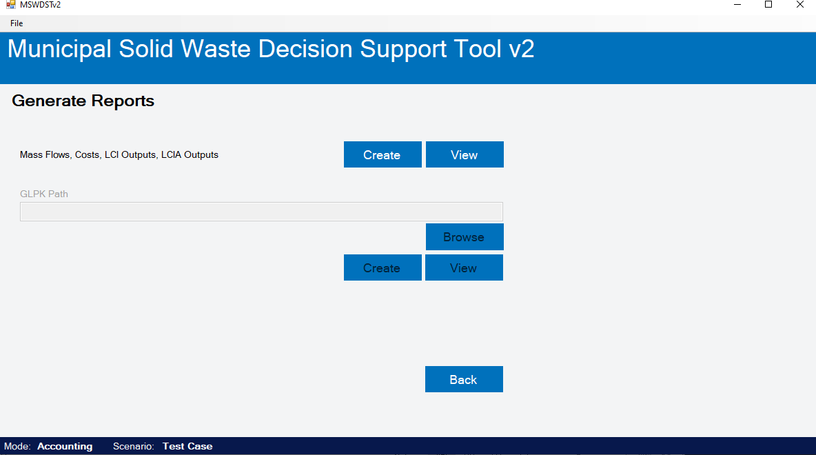
Solve and View Reports Run the Model and Create Results Report
Notes:
The last step allows you to run the model to find a solution for the defined scenario and view the results (MS Excel) report. To run the model and generate a results report, Click the “Create” button. You will then be prompted to name the report and do so using a descriptive and unique name such as “Durham_basecase”. Keep in mind that you cannot use the same report name twice. A text box will pop up after the report has been successfully created. Click the “Ok” button in the text box. You can then click the “View” button to view the created report.
The results file contains the following information in numeric, tabular form:
A mass flow report showing the tonnage of waste collected and sent to each process.
A cost report showing the net total cost and net cost for each process.
A life cycle inventory analysis report showing the net total inventory flow and net flow for each process.
An impact assessment report showing the total impacts by category and for each process.
In accounting mode, you can view results reports using the “View” button. You can also use the “Back” buttons to go back to previous steps in the model to redefine collection and destination options, change the allocation split of waste sent to different destinations, change key assumptions (e.g., electricity grid mix or carbon accounting method), change process model inputs, etc. and re-solve creating a new results report.
In optimization mode, the results for the solution that best meets the optimization objective (e.g., minimum cost) will be displayed. After generating a solution, you have some options for what to do next. You can view results reports using the “View” button. You can also use the “Back” buttons to go back to previous steps in the model to redefine collection and destination options, change the optimized parameter, change key assumptions (e.g., electricity grid mix or carbon accounting method), change process model inputs, etc. and re-solve creating a new results report.
To quit and exit the tool, click on “File” and close the scenario or the “x” in the upper right and the session will close and you will be taken back to the introductory screen. Then click “Exit” and you will be prompted to make sure you want to exit. If so, click “Yes” and the tool will quit.

